Slide 1
Computational and Cognitive Modelling of Language and Web Interaction
Change Perspective
Authors:
Franka Buytenhuijs Daphne Lenders Justine Winkler

Slide 2
Outline
Introduction
Similarity
Blablabla
Questions?

Slide 3
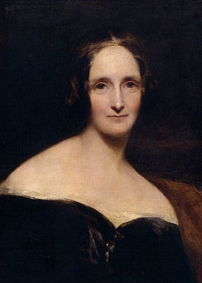
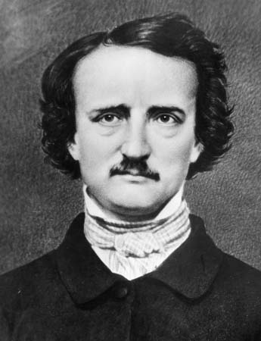
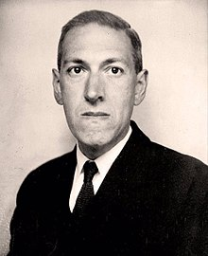
Introduction
Spooky Author Identification
19.5k text entries, containing one of three labels
Mary Shelley
1797 – 1851
Frankenstein
Edgar Allen Poe
1809 – 1849
The Raven
Howard Phillips Lovecraft
1890 – 1937
The Call of Cthulhu

Slide 4
Problem Description
General Problem Authorship Attribution: Too little data
Observation: Authors of kaggle challenge are seperated in „time and space“
Work by Hughes et al.:

Slide 5
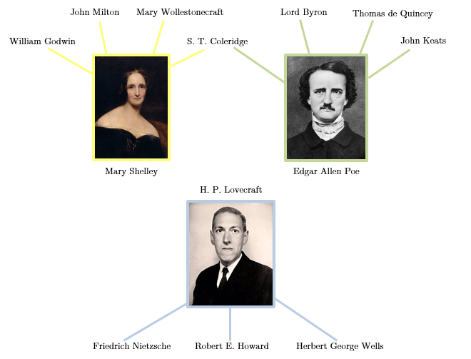
Authors + Influencers

Slide 6
Similarities
Similarity based on function word frequencies
Hughes, J. M., Foti, N. J., Krakauer, D. C., & Rockmore, D. N. (2012). Quantitative patterns of stylistic influence in the evolution of literature. Proceedings of the National Academy of Sciences, 109(20), 7682-7686.

Slide 7
Classifier
- Blabla features

Slide 8
Preliminary Results
- Blabla

Slide 9


QUESTIONS

